Slide 1
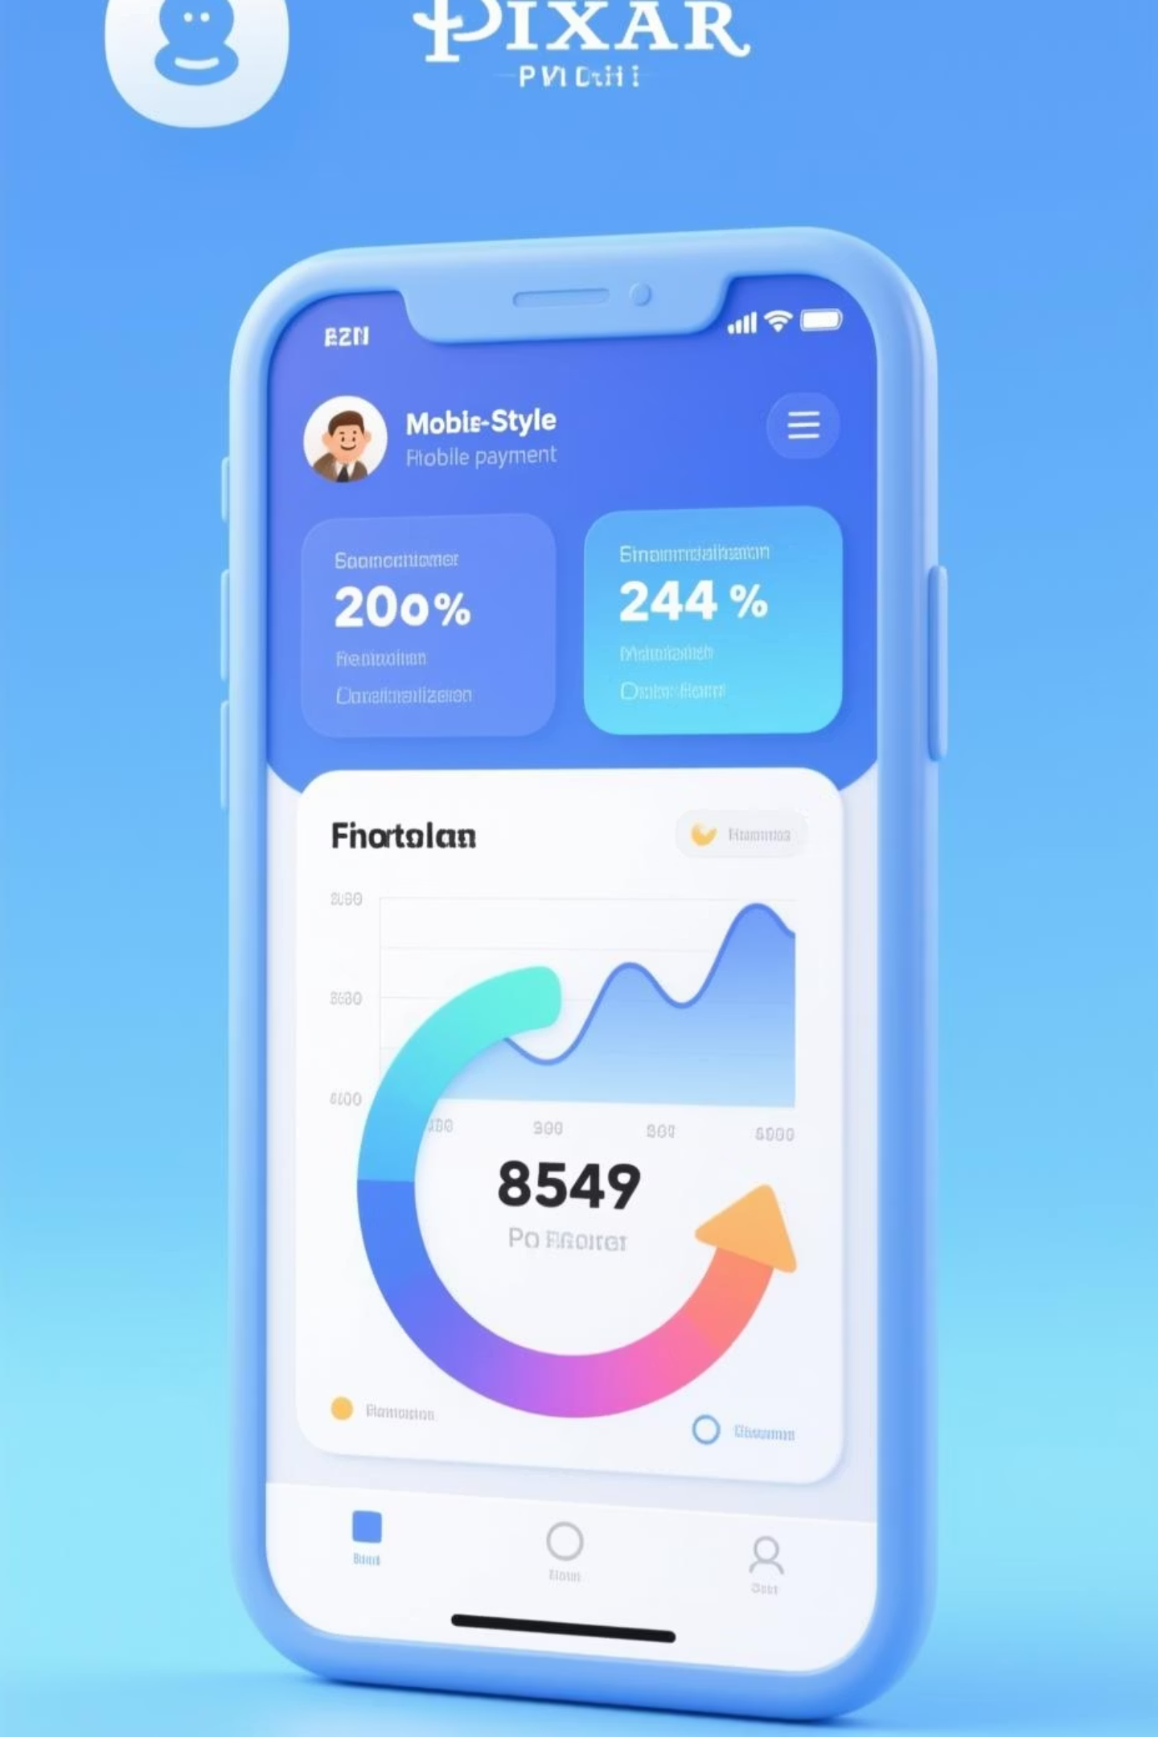
PhonePe Data Analysis
End-to-end performance analysis of business services
01
Revenue Analysis
Identify contributions across services
02
Seasonal Trends
Discover peak performance periods
03
Transaction Failures
Pinpoint improvement opportunities
04
Business Efficiency
Enhance customer experience

Slide 2
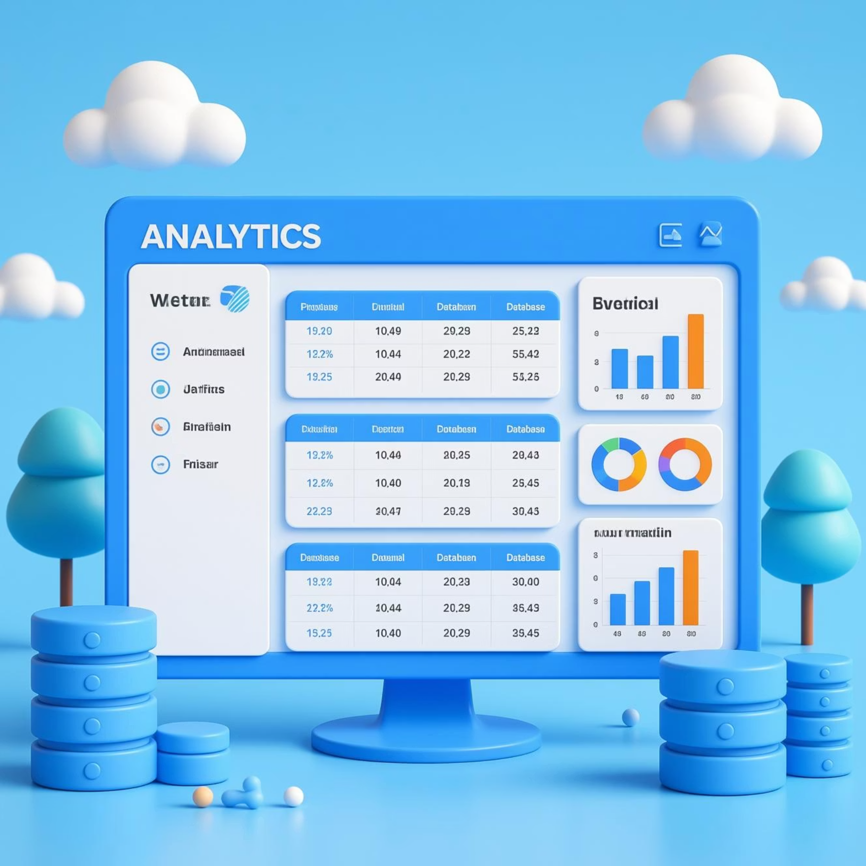
Dataset Overview
User Data
User ID, Name, Age
Join Date tracking
Account creation metrics
Transaction Data
Transaction ID & Amount
Service Category & Type
Payment Status & Reasons
Recharge & Bills
Money Transfer
DTH, Mobile, Utilities
UPI, Bank transfers
Loans
Insurance
Personal, Gold, Business
Bike, Health, Life

Slide 3






Data Cleaning Process
Missing Values
Identified and handled null entries
Outlier Treatment
Detected and treated anomalies in numerical columns
Text Standardization
Applied TRIM and CLEAN functions
Date Formatting
Standardized date formats for consistency
Category Verification
Ensured consistency across tables
Result: Clean, structured, ready-to-analyze dataset using Power BI Power Query

Slide 4
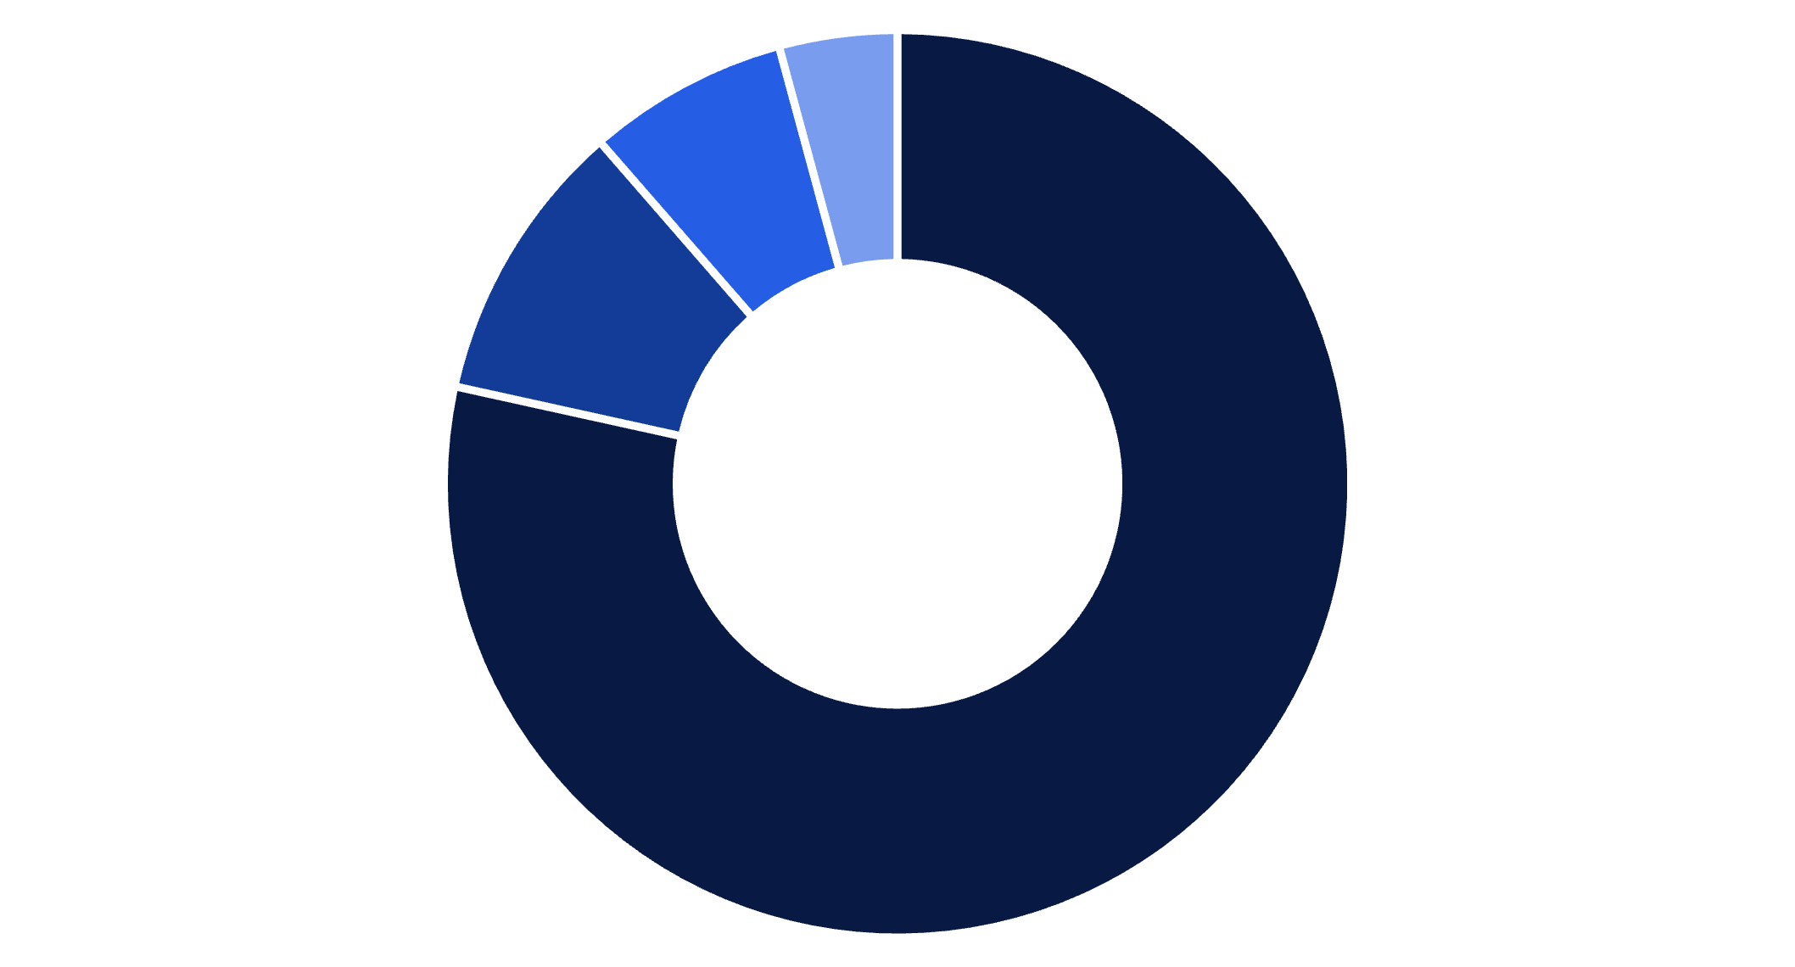
Business Performance Analysis
Revenue Mix by Service
300K
Total Transactions
288K
Successful
96% success rate
12K
Failed
4% failure rate
Loans
Insurance
Money Transfer
Recharge & Bills
Top Failure Reasons
Server Error
Wrong PIN
System-side issues dominate failures
4K+ customer authentication errors
Wrong Info
Insufficient Balance
Incorrect details entered
Financial constraint issues

Slide 5





Seasonal Trends & Service Insights
Monthly Transaction Performance
Peak month: July | Lowest: February | Strongest quarter: Q3 (Jul-Sep)
Insurance
Bike Insurance: 128.10M highest
Success rate: 95.75%
Peaks: March, October
Loans
Peak demand: July-September
Success rate: 95.95%
Gold Loan most popular
Money Transfer
Success rate: 95.98%
UPI slightly leading
Peak month: March
Recharge & Bills
Success rate: 96.16%
Mobile Recharge highest
Stable: 4.1M-4.3M monthly

Slide 6
Key Insights
1
2
3
Revenue Concentration Risk
Infrastructure Challenge
Customer Experience Gaps
Server errors account for most failures
79%+ dependency on Loans—diversification needed
Wrong PIN & Wrong Info errors significant
4
5
Seasonal Patterns
Stable Forecasting Opportunity
Mid-year and festival seasons drive peak transactions
Recharge & Bills show low-volatility trends

Slide 7

Recommendations & Conclusion
Operational Improvements
Business Strategy
Diversify revenue sources
Fix top 3 failure reasons → reduce failures by 95%
Promote underperforming services
Forecasting & Planning
Strengthen server infrastructure
Customer Experience
Use stable trends for predictive modeling
Simplify payment processes
Prepare for peak periods (Q3, festivals)
Introduce low balance alerts
Comprehensive analysis reveals opportunities for operational improvements, customer satisfaction, and revenue diversification. Implementing recommendations will enhance efficiency, reduce failures, and improve user trust.

